Slide 1
Learning Unit 9: The Project Manager, Project Teams and Organisational Structures
Notes:
Teaching strategies
The two real world project management examples in this chapter reinforce the skills needed to be a good project manager and the value of sound project management techniques. Having good business acumen is valuable to help not make decisions that could negatively impact the success of a project. Project managers have the opportunity to create an environment for success.
Implementation of good project management techniques and more employees being trained in project management skills has helped to streamline processes, been beneficial to the company's bottom line, and helped its competitive position.
Many times people say that a project is too small for using project management, but this is not true.
Have learners examine projects that use and do not use project management techniques. Have learners state how using project management skills would be valuable.
Have learners apply project management techniques to their work for one week.
Have learners write their plan and list the tasks, durations, and due dates for the week.
Have them list any additional resources they would need to achieve the tasks.
At the end of the week, have learners compare the week to other weeks and assess the change in what was done and how it was completed. Usually, they will find that they achieved more and wasted less time because of the plan.
Optional supplemental activities
If possible, have each learner interview an experienced project manager (it does not matter in what field) and find out about his/her:
Educational background
Work experience
Views on what it takes to be a good project manager
A discussion of a very challenging issue he or she has faced as a project manager
Have the learners read the chapter and answer all of the Reinforce your learning questions and the questions at the end of the chapter.
Have an experienced project manager speak during a class session and answer questions the learners have about being a project manager.

Slide 2


The Project Manager
Notes:
Teaching strategies
The two real world project management examples in this chapter reinforce the skills needed to be a good project manager and the value of sound project management techniques. Having good business acumen is valuable to help not make decisions that could negatively impact the success of a project. Project managers have the opportunity to create an environment for success.
Implementation of good project management techniques and more employees being trained in project management skills has helped to streamline processes, been beneficial to the company's bottom line, and helped its competitive position.
Many times people say that a project is too small for using project management, but this is not true.
Have learners examine projects that use and do not use project management techniques. Have learners state how using project management skills would be valuable.
Have learners apply project management techniques to their work for one week.
Have learners write their plan and list the tasks, durations, and due dates for the week.
Have them list any additional resources they would need to achieve the tasks.
At the end of the week, have learners compare the week to other weeks and assess the change in what was done and how it was completed. Usually, they will find that they achieved more and wasted less time because of the plan.
Optional supplemental activities
If possible, have each learner interview an experienced project manager (it does not matter in what field) and find out about his/her:
Educational background
Work experience
Views on what it takes to be a good project manager
A discussion of a very challenging issue he or she has faced as a project manager
Have the learners read the chapter and answer all of the Reinforce your learning questions and the questions at the end of the chapter.
Have an experienced project manager speak during a class session and answer questions the learners have about being a project manager.

Slide 3
Chapter Concepts
The responsibilities of the project manager
The skills needed to successfully manage projects and ways to develop project manager competence
Approaches to effective delegation
How the project manager can manage and control changes to the project
Notes:
Chapter concepts
It is the people, not procedures and techniques, who are critical to achieving the project objective.
Procedures and techniques are merely tools that help people do their jobs.
For example, an artist needs to have paint, canvas, and brushes to paint a portrait, but it is the skills and knowledge of the artist that allow a portrait to be created with these tools.
So, too, in project management are the skills and knowledge of the people involved vital for producing the desired result.
This chapter focuses on one very important person: the project manager.
Based on the information in this chapter, learners will become familiar with:
The responsibilities of the project manager
The skills needed to successfully manage projects and ways to develop project manager competence
Approaches to effective delegation
How the project manager can manage and control changes to the project

Slide 4
Learning Outcomes
Discuss three responsibilities of a project manager
Identify, explain, and practice at least five skills and abilities a project manager should have
Explain how one would develop competence as a project manager
Describe how one can effectively use delegation
Explain how to manage changes
Notes:
Learning outcomes
After studying this chapter, the learner should be able to:
Discuss three responsibilities of a project manager
Identify, explain, and practice at least five skills and abilities a project manager should have
Explain how one would develop competence as a project manager
Describe how one can effectively use delegation
Explain how to manage changes

Slide 5
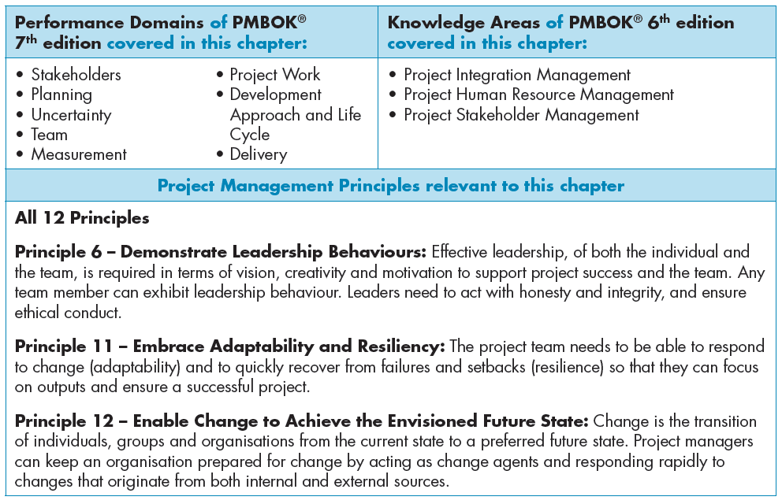

Slide 6
Project Manager Responsibilities
Customer satisfaction
Work scope completion
  Quality manner, within budget, on time
Planning the project
Securing and organising the appropriate resources
Controlling the project progress
Coordinate with team
Control the project
Notes:
Project manager responsibilities
It is the responsibility of the project manager:
To make sure that the customer is satisfied
To ensure that the work scope is completed in a quality manner, within budget and on time
To plan the project
To secure and organise the appropriate resources
To control the project process
To coordinate with the team
The project manager has a primary responsibility for providing leadership in planning, organising, and controlling the work effort to achieve the project objective.
The project manager coordinates the activities of the various team members to ensure that they perform the right tasks at the proper time as a cohesive group.

Slide 7
Planning
Define project objective
Reach agreement with customer
Communicate objective to project team
Create vision of successful achievement
Spearhead plan development
Review plan with customer
Use project management information system
Notes:
Planning
The project manager clearly defines the project objective and reaches an agreement with the customer on the objective.
The manager then communicates this objective to the project team so as to create a vision of what constitutes successful achievement of the objective.
The project manager spearheads development of a plan to achieve the project objective.
The project manager reviews the plan with the customer to gain endorsement and then sets up a project management information system for comparing actual progress to planned progress.

Slide 8
Organising
Secure appropriate resources
Determine in-house tasks
Determine need for subcontractor
Assign responsibility
Delegate authority
Create motivating environment
Notes:
Organising
Organising involves securing the appropriate resources to perform the work.
The project manager must decide which tasks should be completed in-house and which tasks should be handled by subcontractors or consultants.
The project manager also assigns responsibility and delegates authority to specific individuals or subcontractors for the various tasks.
Finally, and most important, the task of organising involves creating an environment in which individuals are highly motivated to work together as a project team.

Slide 9
Controlling
Track actual progress
Compare progress to planned progress
Take necessary actions
Play the leadership role
Involve project team
Notes:
Controlling
To control the project, the project manager must track actual progress and compare it with planned progress.
If actual progress falls behind planned progress or unexpected events occur, the project manager must take immediate action.
The project manager is the leader in planning, organising, and controlling the project, but does not do it alone.
She or he involves the project team in these functions to gain their commitment to successful completion of the project.

Slide 10
Project Manager Skills: Leadership ability
Achieve results through the project team
Use a participative and consultative leadership style
Provide guidance and coaching to the project team
Require involvement and empowerment of the project team
Establish an environment of trust, high expectations, and enjoyment
Have self confidence
Exhibit confidence in the project team
Notes:
Leadership ability
Leadership is getting things done by utilising and bringing out the best work in others; the project manager achieves results through the project team.
Project leadership involves inspiring the people assigned to the project to work as a team.
The project manager must create for the team a vision of the result and benefits of the project.
Effective project management requires a participative and consultative leadership style, in which the project manager provides guidance and coaching to the project team.
The project manager establishes the parameters and guidelines for what needs to be done and the project team members determine how to get it done.
An effective manager does not tell people how to do their jobs.
Project leadership requires involvement with and empowerment of the project team.
The project manager should involve individuals in decisions affecting them and should empower them to make decisions within their assigned areas of responsibility.
The capable project manager understands what motivates team members and creates a supportive environment in which individuals work as part of a high-performing team and are energised to excel.
The project manager must be careful not to create situations that cause individuals to become discouraged.
The project manager must foster motivation through recognition of the project team as a whole and of individual members. Recognition should be carried out as soon as possible after the action that is being recognised.
The project manager sets the tone for the project team by establishing an environment of trust, high expectations, and enjoyment.
Capable project managers have high expectations of themselves and of each person on the project team. They believe that people tend to live up to what is expected of them.
Project managers tend to be optimistic and positive.
Project managers should encourage the same positive attitude on the part of the project team members and facilitate the team building process.
Leadership requires that the project manager be highly motivated and set a positive example for the project team.
The project manager has self-confidence and exhibits confidence in the project team members.

Slide 11
Ability to develop people
Train and develop the project team
Believe that all individuals are valuable
Encourage initiative
Identify situations for mentoring
Assess opportunities for growth
Encourage self reflection for learning
Notes:
Ability to develop people
The effective project manager is committed to training and developing the skills of people working on the project.
He or she uses the project as an opportunity to add value to each person’s experience base so that all members of the project team are more knowledgeable and competent at the end of the project than when they started.
One way of encouraging such activities is to talk about the importance of self-development at project team meetings.
Another way is to meet with project team members individually at the start of their project assignments and encourage them to take advantage of opportunities to expand their knowledge and skills.
A good project manager believes that all individuals are valuable to the organisation and that they can make greater contributions through continuous learning.
He or she stresses the value of self-improvement by encouraging individuals to take the initiative.
A capable project manager provides opportunities for learning and development by encouraging individuals to take initiative, take risks, and make decisions.
Rather than create a fear of failure, the manager acknowledges that mistakes are part of the learning and growth experience.
The project manager can try to provide 'stretch' assignments that require individual team members to extend their knowledge and achieve more than they may think they can.
A project manager can also is identify situations in which less experienced people can learn from more experienced people.
A final way in which the project manager can develop people is by having them attend formal training sessions.
The project manager might even provide coaching.
During individual meetings with the project team members, managers should assess opportunities for growth by having the members identify what they learnt by working on the project.

Slide 12
Communication skills
Be good communicators
Communicate and share information
Spend more time listening than talking
Inform the customer of progress
Determine any changes
Provide timely feedback to the team and customer
Notes:
Communication skills
Project managers must be good communicators.
They need to communicate regularly with the project team, as well as with any subcontractors, the customer, their own company’s upper management, and other stakeholders.
Effective and frequent communication is crucial for keeping the project moving, identifying potential problems, soliciting suggestions to improve project performance, keeping abreast of customer satisfaction and stakeholder issues, and avoiding surprises.
A high level of communication is especially important early in the project.
Effective project managers communicate and share information in a variety of ways.
These tasks require that the project manager have good verbal and written communication skills.
Good project managers spend more time listening than talking.
The project manager establishes ongoing communication with the customer and other stakeholders to keep the customer and other stakeholders informed and to determine whether there are any changes in expectations.
Communication by project managers needs to be timely, honest, and unambiguous.
Effective communication establishes credibility and builds trust.
It is important for the project manager to provide regular feedback to the team and customer.
Both the good news and the bad news should be shared promptly.
The project manager must create an atmosphere that fosters timely and open communication without any fear of reprisal.

Slide 13
Interpersonal skills
Develop a relationship with each team member
Maintain interpersonal relationships for duration of the project
Influence the thinking and actions of others
Deal with disagreements or divisiveness
Notes:
Interpersonal skills
Good interpersonal skills are essential for a project manager.
It is important that the project manager develop a relationship with each person on the project team.
Mangers should make the time to have an informal conversation with each person on the project team and with each key individual in the customer’s organisation.
The project manager should try to learn about the personal interests of each team member without being intrusive.
In informal conversations, the project manager should use open-ended questions and do a lot of listening.
Good interpersonal skills enable a project manager to empathise with individuals when circumstances arise.
An effective project manager develops and maintains these interpersonal relationships throughout the duration of the project.
A project manager needs good interpersonal skills to influence the thinking and actions of others in ways that help achieve the objective of the project.
A project manager also needs good interpersonal skills to deal with disagreement or divisiveness among team members. Such situations can require delicate handling on the project manager’s part.

Slide 14
Ability to handle stress
Must be able to handle the stress
Remain calm
Cope with constantly changing conditions
Act as a buffer between the project team and either the customer or upper management
Have a good sense of humour
Keep physically fit to improve ability to handle stress
Notes:
Ability to handle stress
Project managers must be able to handle the stress that can arise from work situations.
Stress is likely to be high when a project is in jeopardy of not meeting its objective.
The project manager cannot panic; she or he has to remain calm.
The effective project manager is able to cope with constantly changing conditions.
In certain situations, the project manager may need to act as a buffer between the project team and either the customer, stakeholders, or upper management.
The project manager needs to have a good sense of humour.
Used appropriately, humour can help a project manager handle the stress and break the tension.
The project manager can improve her or his ability to handle stress by keeping physically fit through regular exercise, good nutrition, and a healthy lifestyle.

Slide 15
Problem-solving skills
Be a good problem solver
Start with the early identification of a problem or potential problem
Encourage project team members to identify problems early and solve them
Notes:
Problem-solving skills
A project manager needs to be a good problem solver.
Good problem solving starts with the early identification of a problem or potential problem.
The project manager should encourage project team members to identify problems early and solve them on their own or seek help if they need to.
Problem-solving will be discussed in greater detail in Chapter 11.

Slide 16
Negotiating skills
Employ negotiating skills in interactions
Develop a trusting relationship with the other person
Use effective listening
Take cultural differences into consideration
Strengthen relationships, not erode them
Notes:
Negotiating skills
Good negotiating skills are essential for project managers.
During the project life cycle, project managers encounter many occasions to employ their negotiating skills in interactions with the sponsor or customer, the project organisation’s management, subcontractors, vendors, end users of the project’s product, and other stakeholders.
The subject of negotiations can be contract terms and conditions, obtaining specific resources to staff the project, subcontractor prices, vendor delivery schedules, payment for damages, the cost or schedule impact of changes, customer approval of designs, the need for rework if quality standards were not met, the best approach to resolve a technical performance issue, interpretation of acceptance criteria or test results, approaches to get the project back on track if it is behind schedule and/or over budget, and stakeholder concerns about the impact or safety of a project.
It is helpful if the project manager has developed a trusting relationship with the other party because this can provide a strong foundation for positive and robust negotiations.
The project manager needs to be an effective listener and to be able to make a persuasive case and clearly articulate his or her position on issues.
Negotiating with customers or subcontractors involved in global projects can be particularly challenging. The project manager must take cultural differences into consideration when negotiating.
Effective negotiations strengthen relationships, not erode them.

Slide 17
Time management skills
Manage time well
Have self-discipline
Be able to prioritise
Show a willingness to delegate
Notes:
Time management skills
Good project managers manage their time well. Project managers must:
Have self-discipline
Be able to prioritise
Show a willingness to delegate
Time management is discussed more thoroughly in Chapter 11.

Slide 18
Delegation
Delegating
Barriers to delegating
Empower the project team
Use effective communication skills
Select the most qualified project team members
Can do it better or faster yourself
Lack confidence in the capability of others
Afraid will lose control
Fear criticism for mistakes
Lack self-confidence
Notes:
Delegation
Delegation involves empowering the project team to achieve the project objective and empowering each team member to achieve the expected results for his or her area of responsibility.
It is the act of allowing individuals to successfully carry out assigned tasks.
Delegation implies more than just assigning tasks to specific members of the project team.
It includes giving team members the responsibility to achieve job objectives and the authority to make decisions and take actions to achieve the expected results, as well as accountability for achieving those results.
Effective delegation requires effective communication skills.
The project manager has the responsibility for providing a clear understanding of what is expected in terms of specific results.
The project manager should not tell the individuals how to do the task. That should be left up to the individuals so that they can be creative.
Delegating is an important part of being a good project manager. It involves selecting the project team members who are best qualified to perform each task and then empowering them to do it.
Effective delegation requires that the project manager have confidence in each member of the project team.
There are a number of common barriers to effective delegation:
The project manager has a personal interest in the task, or thinks he or she can do it better or faster him or herself.
The project manager lacks confidence in the capability of others to do the work.
The project manager is afraid that he or she will lose control of the work and not know what is going on.
Team members fear criticism for mistakes or lack self-confidence.

Slide 19
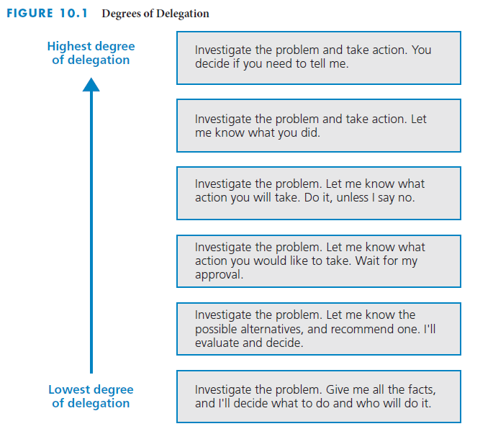
Various degrees of delegation
Notes:
Various degrees of delegation
The figure on this slide depicts various degrees of delegation, from lowest degree at the top to highest degree at the bottom.

Slide 20
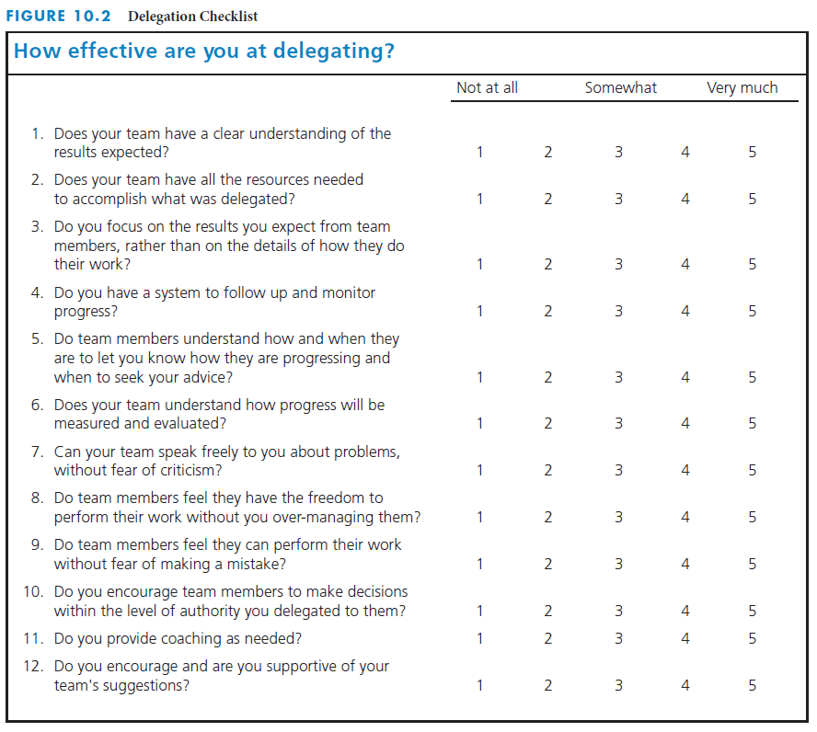
Checklist for rating delegation effectiveness
Notes:
Checklist for rating delegation effectiveness
The checklist on this slide is a tool for rating your effectiveness at delegation.

Slide 21
Managing Changes
Initiation of change
Manage and control change
By the customer
By the project team
Caused by unanticipated occurrences
Required by the users of the project results
Establish procedures for communication
Estimate impact of change
Decide about the change
Customer approves change
Notes:
Managing change
The one thing that you can be sure will happen during a project is change. Despite the best laid plans, changes will still occur.
Changes may be:
Initiated by the customer
Initiated by the project team
Caused by unanticipated occurrences during the performance of the project
Required by the users of the project results
An important aspect of the project manager’s job is to manage and control changes.
Generally, the later in the project that changes are identified, the greater their impact on achieving the project objective.
The aspects most likely to be affected are the project budget and the completion date.
At the start of the project, procedures need to be established regarding how changes will be documented and authorised.
These procedures must cover communication between the project manager and the customer and between the project manager and the project team.
Whenever a customer requests changes, the project manager should have the appropriate project team members estimate the effects on the project cost and schedule.
The project manager needs to be sure that team members will not casually agree to changes that may require additional work hours.
Open communication and a climate of trust are prerequisites for introducing change, reducing resistance to change, and gaining commitment to the change.
If possible, the project manager should have users participate up front in the decision to make changes.

Slide 22

The Project Team
Notes:
Teaching strategies
The two real world project management examples in this chapter reinforce the need for understanding motivation in project teams, and acknowledging and harnessing diversity in project management.
Diversity is more than merely having team members of different genders and races. It also means having a team with a wide range of perspectives and viewpoints that can enrich a project.
Having members of the staff who are from different cultures or who are culturally aware helps to create a more inclusive environment and project team.
Different ideas can be a productive and important force. It makes members of the team think about different ideas and debate those ideas.
Complacency leads to not caring and unsatisfied members of the team.
Have learners evaluate their work on their class project team. Have them evaluate their project team's effectiveness.
Project teams are part of nearly every organisation. Observe project teams and their interactions. Evaluate the project team effectiveness. Determine how the project team can improve and what they are doing well.
Optional supplemental activities
Have each learner prepare a one-page summary of a team situation in which they have been involved and the results of that experience.
Have each learner interview someone working in a business who is involved in a team project. Get them to summarise the project and then have a discussion on the specific advantages and disadvantages of that team.
Have learners read the chapter and answer all of the Reinforce your learning questions and the questions at the end of the chapter.
Have learners interview members of PMI about ethics issues in project management and then report the findings of the interview to the class. Have learners research responsibility, respect, fairness, and honesty in PMI's Code of Ethics and Professional Conduct.

Slide 23
Chapter Concepts
How teams are acquired and assigned
The development and growth of teams
The project kick-off meeting
Characteristics of effective project teams and barriers to effectiveness
Being an effective team member
Team building
Valuing team diversity
Ethical behaviour
Sources of conflict during the project and approaches to handling conflict
Problem solving and brainstorming
Effective time management
Notes:
Chapter concepts
A project team is a group of individuals working interdependently to achieve the project objective. Team work is the cooperative effort by members of a team to accomplish this common goal.
The effectiveness, or lack thereof, of the project team can make the difference between project success and project failure.
Although plans and project management techniques are necessary, it is the people – the project manager and the project team – who are the key to project success; project success requires an effective project team.
This chapter covers the development and maintenance of an effective project team.
Based on material in this chapter, learners will become familiar with:
How teams are acquired and assigned
The development and growth of teams
The project kick-off meeting
Characteristics of effective project teams and barriers to effectiveness
Being an effective team member
Team building
Valuing team diversity
Ethical behaviour
Sources of conflict during the project and approaches to handling conflict
Problem solving and brainstorming
Effective time management

Slide 24
Learning Outcomes
Explain how teams are assigned and formed
Explain each stage of team development
Plan and conduct a project kick-off meeting
Discuss characteristics of effective teams
Identify and describe at least five barriers to team effectiveness
Be an effective team member
Take actions to support team building
Identify at least five dimensions of diversity, and discuss the value of team diversity
Behave ethically in a project environment
Identify at least four sources of conflict on projects, and explain how to handle conflict
Apply the problem-solving process and the brainstorming technique
Manage time effectively
Notes:
Learning outcomes
After studying this chapter, learners should be able to:
Explain how teams are assigned and formed
Explain each stage of team development
Plan and conduct a project kick-off meeting
Discuss characteristics of effective teams
Identify and describe at least five barriers to team effectiveness
Be an effective team member
Take actions to support team building
Identify at least five dimensions of diversity, and discuss the value of team diversity
Behave ethically in a project environment
Identify at least four sources of conflict on projects, and explain how to handle conflict
Apply the problem-solving process and the brainstorming technique
Manage time effectively

Slide 25
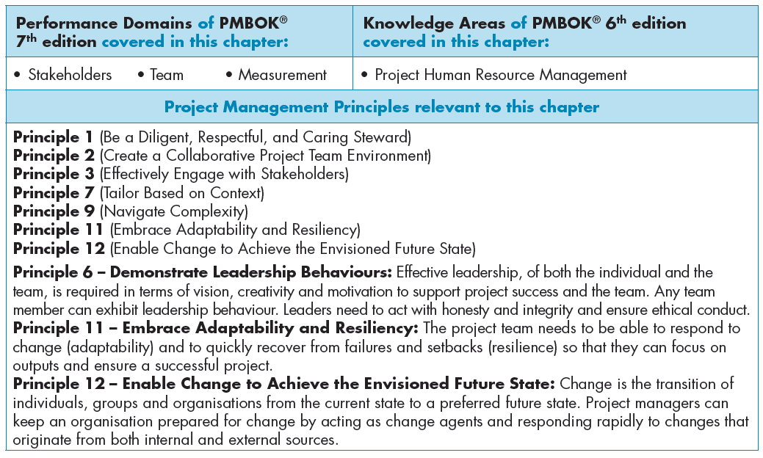

Slide 26
Acquiring the Project Team
Project teams
  What expertise, experience, or skills needed
  How many of each type are required
  When they will be needed
    Acquire entire team for smaller projects
    Assemble team members as needed for larger projects
Greatest constraint is the availability of the right resources at the right time
May have to negotiate for resources
Keep team as small as feasible
Notes:
Acquiring the project team
In many projects, people who have never worked together are assigned to the same project team.
A personal relationship between two people takes time to develop and teams evolve over time through various stages of development.
One of the first things that project manager must do is to obtain and put together a project team. There are a number of considerations to take into account when assembling a team:
What expertise, experience, or skills are needed for the project
How many of each type of expert are required
When they will be needed
Acquire entire team at the beginning for smaller projects
Assemble team members as needed for larger projects
Usually, the greatest constraint when acquiring a project team is the availability of the right resources at the right time.
In larger organisations, the project manager may have to negotiate for resources
Project teams should be kept as small as feasible throughout the project

Slide 27
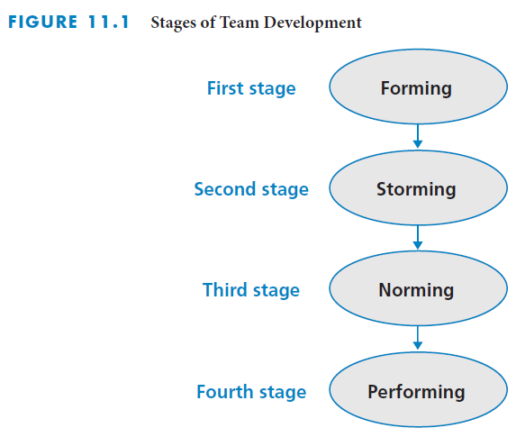
Project Team Development
Notes:
Project team development
B.W. Tuckman has defined four stages of team development: forming, storming, norming, and performing
The figure on this slide illustrates those different stages of team development.

Slide 28
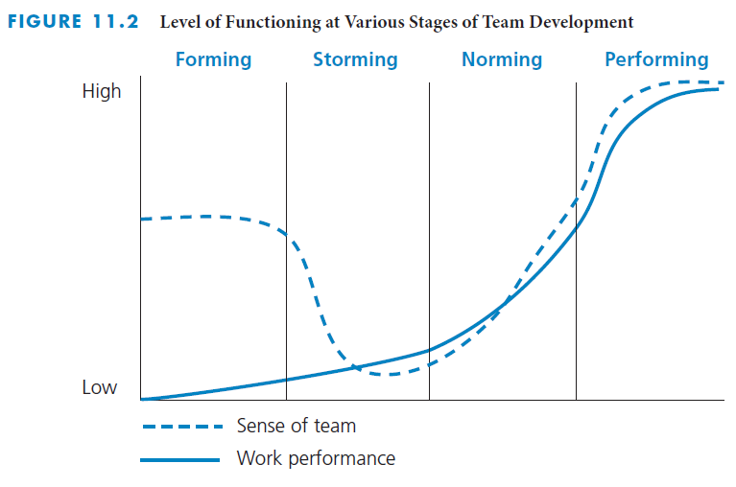
Forming
Initial stage
Individuals get acquainted
Positive expectations
Little work achieved
Depend on direction and structure
Lots of questions
  What purpose?
  Who are others?
  What are they like?
Notes:
Forming
The figure on this slide illustrates the levels of work performance and sense of team for the four different stages of team development. Notice how the sense of team generally weakens and then strengthens again as team members learn to work with one another.
Forming is the initial stage of the team development process. It involves the transition from individual to team member.
Individuals get acquainted.
Team members generally have positive expectations going into this stage.
The group begins to establish an identity and attempts to define and plan the tasks that need to be done. Little actual work is achieved.
Members depend on the project manager to provide direction and structure.
Feelings characteristic of this stage include excitement, anticipation, suspicion, anxiety, and hesitancy.
Individuals do a lot of questioning in the forming stage:
What is our purpose?
Who are the other team members?
What are they like?
The project manager must clearly communicate the project objective and create a vision of the successful result of the project and the benefits it will provide.
Project constraints regarding the work scope, quality levels, budget, and schedule must be stated.
Establishing structure is another task the project manager must perform in this phase. This includes defining initial processes and procedures for team operation and addressing such items as communication channels, approvals, and paperwork.

Slide 29
Storming
Second stage
Start to apply their skills to work
Tasks may be larger than anticipated
Increasing dissatisfaction with dependence
Test the limits and flexibility of the team
  Conflict emerges and tension increases
  Motivation and morale are low
  Members express individuality
Notes:
Storming
The second stage of team development is known as storming.
Members start to apply their skills to work on their assigned tasks, and work begins to progress slowly.
Tasks may be more extensive or difficult than anticipated.
Team members feel increasing dissatisfaction with dependence on the direction or authority of the project manager.
Team members begin to test the limits and flexibility of the project manager and the ground rules.
Conflict emerges and tensions increase.
Motivation and morale are low in this stage.
Members express their individuality as opposed to team allegiance.
The storming stage is characterised by feelings of frustration, anger, and hostility.
The project manager still needs to give a lot of directions, but can be less directive than in the forming stage.
The project manager should not become defensive or take issues personally.
This is the time for the project manager to provide an understanding and supportive environment.

Slide 30
Norming
Third stage
Relationships have settled
Interpersonal conflicts resolved
Team has accepted its operating environment
Control and decision making are transferred to the project team
Cohesion begins to develop
Trust begins to develop
Team members give and ask for feedback
Feeling of camaraderie emerges
Notes:
Norming
After struggling through the storming stage, the project team moves into the norming stage of development.
Relationships have become settled by this stage.
Interpersonal conflicts have been resolved.
The project team has accepted its operating environment.
Control and decision making are transferred from the project manager to the project team.
Cohesion begins to develop.
Trust begins to develop in this stage.
Team members give and ask for feedback from each other.
A feeling of camaraderie emerges.
The project manager minimises his or her directing role and takes on a more supportive role.
Work performance accelerates and productivity increases.

Slide 31
Performing
Fourth stage
High commitment to achieve project objective
High level of work performance
Communication is open
Collaboration and willingness to help each other
Team feels fully empowered
Project manager fully delegates responsibility and authority
Project manager is mentor
Notes:
Performing
The fourth and final stage of team development and growth is the performing stage.
The team is highly committed and eager to achieve the project objective.
The level of work performance is high.
Communication is finally very open.
Members frequently collaborate and willingly help each other.
The team feels fully empowered.
The project manager fully delegates responsibility and authority.
The project manager concentrates on project performance with respect to the budget, schedule, scope, and plan.
The project manager acts as a mentor, supporting the professional growth and development of the members of the team.

Slide 32
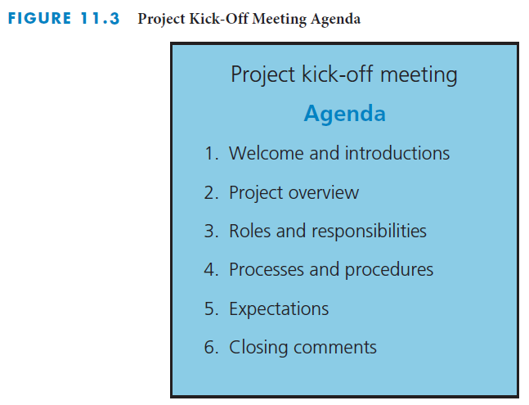
Project Kick-off Meeting
Project orientation
Held as early as possible
Sets the tone for the project
Provides opportunity for team to know each other
Clarify roles and responsibilities
Describe protocols and plans
Allow time for questions and comments
Notes:
Project kick-off meeting
The project manager should schedule a project kick-off meeting, also known as a project orientation meeting, with the project team.
It should be held as early as possible during the forming stage of team development
It helps to set the tone for the project
It provides an early opportunity for the team to get to know each other
It helps to clarify any confusion about team members’ roles and responsibilities
It gives the project manager a chance to describe protocols and plans
The manager should always allow some time for questions and comments at the end
The figure on this slide depicts the project kick-off meeting agenda. There are six general parts to the project kick-off meeting.
Welcome and introductions – provides an opportunity for team members to get to know each other and the potential value and contributions to the project
Project overview – discuss the elements of the project charter
Roles and responsibilities – clarify the roles and responsibilities of the team members
Processes and procedures – describe the protocols and plans for the project
Expectations – express expectations of the project and the experiences expected for team development
Closing comments – reinforce the expectations and the roles and allow tem members to ask questions, make comments, and get to know each other

Slide 33
Effective Project Teams
More than a group of individuals
  Group of interdependent individuals
  Work cooperatively to achieve the project objective
Develop and grow into a cohesive, effective team
  Takes effort on the part of the project manager and each member
Notes:
Effective project teams
A project team is more than merely a group of individuals.
It is a group of interdependent individuals working cooperatively to achieve the project objective.
Helping these individuals develop and grow into a cohesive, effective team takes effort on the part of the project manager and each member of the project team.

Slide 34
Characteristics of effective teams
Clear understanding of the project objective
Clear expectations of each person’s role and responsibilities
Results orientation
High degree of cooperation and collaboration
High level of trust
Notes:
Characteristics of effective teams
While teams can differ widely from project to project and organisation to organisation, most teams share certain characteristics. Effective teams all have:
A clear understanding of the project objective
Clear expectations of each person’s role and responsibilities
An orientation geared toward results
A high degree of cooperation and collaboration
A high level of trust between its members

Slide 35
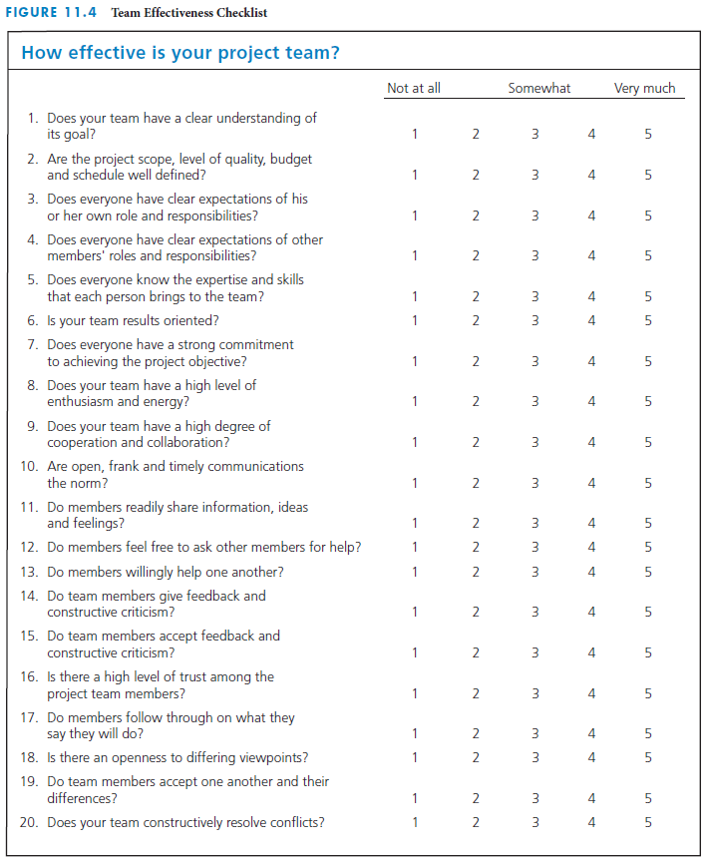
Rate team effectiveness
Notes:
Rate team effectiveness
The figure on this slide depicts a checklist for rating the effectiveness of a project team. A checklist like this can help organisations to keep track of how well project teams are working.

Slide 36
Team building
An ongoing process
The responsibility of both the project manager and the project team
Socialising supports team building
Enhanced by members getting to know one another
  Discussions not all work related
  Initiate social events to celebrate achievements
Have team meetings, not just project meetings
Notes:
Team building
Legendary baseball manager Casey Stengel once said, 'It’s easy to get the players. Gettin’ ’em to play together, that’s the hard part.' It can be difficult to organise a group of people with different opinions, perspectives and life experiences and get them to work together effectively.
Team building is an ongoing process.
It is the responsibility of both the project manager and the project team to make a team effective.
Socialising among team members supports team building.
The better that team members get to know one another, the stronger the team will become.
When team members are located near one another, there is a greater chance that they will talk.
This will involve allowing team members to engage in non-work-related discussions.
It is important to let team members get to know one another personally without the manager intruding.
The project team should engage in social events to celebrate project milestones and achievements.
An after-work pizza party, a team luncheon, an informal lunch in the conference room, or a trip to see a sports event or theatre production are examples of events the team can organise to foster socialisation and team building. It is important that team activities include everyone on the team – if half the team hates baseball, do not organise an outing to see a baseball game.
In addition to organising social activities, the team should have periodic team meetings, which are not the same as project meetings.
The purpose of team meetings is to discuss openly such questions as: How are we working as a team? What barriers are hindering team work? What can we do to overcome these barriers? What can we do to improve team work?
Only team-related issues, not project items, should be discussed at team meetings.
Team members should foster team building in whatever ways they can. They should not expect the project manager alone to be responsible for team building.

Slide 37
Valuing team diversity
Acknowledge, understand, and value differences
  Create a work environment that recognises, respects, and harnesses differences
  Achieve a shared goal
Differences can create barriers to team performance
  May lead to miscommunication and misunderstanding
  Can result in low morale, diminished trust, reduced productivity, greater tension, and suspicion
  Can become a serious impediment, if not managed properly
Under good management, diversity can lead to more creative, faster results, and higher-quality problem solving and decision making
Notes:
Valuing team diversity
Diversity involves the differences among people. Many workplaces these days are fairly diverse places, with employees of different racial, ethnic and cultural backgrounds.
Having a successful diverse workplace involves acknowledging, understanding, and valuing differences and creating a work environment that recognises, respects, and harnesses differences among team members for the benefits of achieving a shared goal.
However, diversity creates challenges. Differences in viewpoints between team members can create barriers to team performance.
Miscommunication and misunderstanding may be more likely to happen between people who come from different backgrounds.
If the differences within the project team are not valued as a strength, they can lead to low morale, diminished trust, reduced productivity, greater tension, and suspicion.
The diversity that could, if utilised properly, be a strength can become a serious impediment to team performance.
Under good management, diversity can lead to more creative, faster, and higher-quality problem solving and decision making.

Slide 38
Valuing team diversity actions
Should NOT do
Should do
Stereotype or make assumptions
Exclude or have lower expectations
Draw attention to diversity
Make derogatory or insensitive remarks because it demeans the dignity of others
Tell jokes, ridicule, or make fun
Create and sustain a supportive and positive climate
Develop a written diversity policy
Provide diversity training
Raise awareness and create understanding
Help diminish misunderstanding and conflict
Make a personal commitment to understand, value, and respect diversity
Notes:
Valuing team diversity actions
Good project managers must be careful when dealing with a diverse project team. Diversity can be an incredible asset, when well managed. There are a number of things that managers should definitely do and should never do, as you can see in this slide.
Managers should NOT:
Stereotype or make assumptions
Stereotyping is categorising individuals into a group and then conferring on them the characteristics that one falsely believes apply universally to all members of that group. Everyone is unique and should be treated as such.
Exclude team members or have lower expectations for them
Everyone should be expected to perform at a high level, regardless of their background. Every team member should also be made to feel included in the project.
Draw attention to diversity
It is unfair and will make team members uncomfortable to draw attention to the things that make them different from the group.
Make derogatory or insensitive remarks because it demeans the dignity of others
It should be fairly obvious that derogatory remarks are never acceptable. It will make team members feel persecuted and will affect their performance.
Tell jokes, ridicule, or make fun
It is inappropriate for team members to tell jokes, ridicule, or make fun of a diversity characteristic of a team member or a particular group. Even if the jokes are not meant to be mean, they can be interpreted as such.
Any diversity issues or conflicts should be addressed immediately so they can be resolved before they fester and ‘explode’ at a later time. Team members should feel like they have a safe communication outlet for reporting inappropriate behaviours.
Managers SHOULD:
Take whatever steps necessary to create and sustain a supportive and positive climate for diversity.
Develop a written policy regarding diversity
This is a good way to ensure that all employees are clear on the organisation’s diversity policy.
Provide training about diversity in the workplace
Increasingly, organisations recognise the value of a diverse workplace and offer diversity training. This can be a good way to teach employees how to work together in diverse teams without inadvertently offending anyone.
An effective diversity training session should raise awareness, create understanding, and help reduce misunderstanding and conflict.
Managers should work to raise awareness of diversity and to create understanding of it and its value
Barriers to valuing diversity include lack of awareness and lack of understanding.
Conversely, the project manager must promote and foster a respectful and supportive work environment that helps to reduce potential misunderstandings and conflicts.
Team members should also take steps to make a personal commitment to understand, value, and respect diversity.
Individual team members can make a personal commitment to understand and value diversity and respect the differences of other team members.
Having a common goal, such as the project objective, can bring a diverse group together.

Slide 39
Ethical Behaviour
Opportunities for unethical behaviour
  Some circumstances are debatable regarding misbehaviour
  Project manager’s responsibility to set the tone and expectations
Actions to prevent wrongdoing
  Have a policy on ethical behaviour
  Conduct training sessions on ethical behaviour
Non-threatening process to report any actions
Members must feel accountable
Notes:
Ethical behaviour
With so many examples of businesses failing because of unethical behaviour, it should be clear how important ethical behaviour is to project and organisational success.
Ethical behaviour is necessary within a project organisation and in project business relationships with customers, suppliers, and subcontractors.
Customers and suppliers want to do business with people they can trust.
It is important for team members and the project manager to clearly and honestly communicate information to the customer.
Withholding or falsifying information is unacceptable.
For example, it is important that a customer is informed of a potential problem in timely manner that is neither unnecessarily alarming, nor misleading.
There can be many opportunities for unethical behaviour in today’s business environment:
Dishonestly in time card reporting of hours worked, resulting in overcharges to the customer
Padding or falsifying travel expense reports
Plagiarising work of others and taking credit for it
Knowingly approving test results that are inaccurate
Taking project supplies or using project equipment for personal use
Putting pressure on the project team to charge more or fewer hours than they actually worked to mislead management or the customer that the project expenditures are within budget
Knowingly approving test results that are inaccurate
Paying off inspectors to approve work that otherwise may not have passed inspection
However, not all behaviour and circumstances are clearly unethical or ethical – grey areas are common in the workplace.
It is the project manager’s responsibility to set the tone and expectations and to exemplify ethical behaviour.
There are actions that an organisation can take to prevent wrongdoing. Two of them are:
Having a policy on ethical behaviour. This includes topics on expectations, process for reporting misconduct, and consequences of engaging in unethical practices. Project managers should also regularly discuss the importance of ethical behaviour at project team meetings.
Conducting training sessions on ethical behaviour. Training informs the project team of the organisation’s ethics policy. Incorporating case studies or role-play can be helpful.
Employees who participate in ethics training are less likely to engage in unethical behaviour.
Training sends a message that the organisation places high value on ethical behaviour.
Organisations should punish instances of misconduct or conflict of interest in order to send a clear message to all employees that misconduct is not tolerated.
Ethical behaviour should be discussed as part of orientation for new employees so as to start sending a clear and consistent message from the very first day.
Project members should feel comfortable bringing possible ethical situations to the attention of the project manager.
When wrongdoing is reported, the project organisation must thoroughly investigate the allegations to determine the facts and to decide if disciplinary action is warranted.
Ethical behaviour is everyone’s responsibility. Team members must feel that they are accountable for their actions.
Members of the project team should pressure any members engaging in questionable behaviour by communicating that they do not agree with, or condone, their behaviour.

Slide 40
Key principles to guide ethical behaviour
Treat others the way you want to be treated
Don’t do anything you wouldn’t want your family, friends, neighbours, or co-workers to read about in the newspaper or hear on the news
Notes:
Key principles to guide ethical behaviour
Here are two key principles to guide ethical behaviour:
Treat others the way you want to be treated.
Don’t do anything you wouldn’t want your family, friends, neighbors or co-workers to read about in the newspaper or hear on the news.

Slide 41
Conflicts on Projects
Sources of conflict
Handling conflict approaches
Work scope
Resource assignments
Schedule
Cost
Priorities
Organisational issues
Stakeholder issues
Personal differences
Avoiding or withdrawing
Competing or forcing
Accommodating or smoothing
Compromising
Collaborating, confronting, or problem solving
Notes:
Conflicts on projects
Conflict is not always a bad thing that should be avoided. When working in teams on projects, conflict is inevitable. Conflict can actually be a productive force.
Differences of opinion between team members are natural and must be expected.
Moments of conflict provide an opportunity to gain new information, consider alternatives, develop better solutions to problems, enhance team building, and learn.
There are seven main sources of potential conflict on projects.
Work scope: Conflict can arise from differences of opinion on how the work should be done, how much work should be done, or at what level of quality the work should be done.
Resource assignments: Conflict can arise over the particular individuals assigned to work on certain tasks, or over the quantity of resources assigned to certain tasks.
Schedule: Conflict can result from differences of opinion about the sequence in which the work should be completed, or about how long the work should take.
Cost: Conflict often arises over how much the work should cost.
Priorities: Conflict can result when people are assigned to work on several different projects concurrently, or when various people need to use a limited resource at the same time.
Organisational issues: Organisational issues can cause conflict. There may be disagreement over the need for certain procedures established by the project manager, or ambiguous project communication, or from failure to make timely decisions.
Stakeholder issues: Conflict can arise from issues with certain stakeholders
Personal differences: Conflict can emerge among members of the project team because of differences in individuals’ values and attitudes.
Conflict is not just for the project manager to handle and resolve; conflict between team members should be handled by the individuals involved.
Handled properly, conflict can be beneficial. It allows problems to surface and be addressed through stimulating discussion and encouraging people to clarify their views. It can force individuals to search for new approaches; it can foster creativity and enhance the problem-solving process.
There are five main approaches to handling conflict:
Avoiding or withdrawing. Individuals in conflict retreat from the situation in order to avoid an actual or potential disagreement.
This approach can cause the conflict to fester and then escalate at a later time.
Competing or forcing. In this approach, conflict is viewed as a win–lose situation in which the value placed on winning the conflict is higher than the value placed on the relationship between the individuals.
This approach to handling conflict can result in resentment and deterioration of the work climate.
Accommodating or smoothing. This approach emphasises finding areas of agreement within the conflict and minimises addressing differences. Topics that may cause hurt feelings are not discussed.
Although this approach may make a conflict situation livable, it does not resolve the issue.
Compromising. Team members search for an intermediate position.
The solution may not be the optimal one.
Collaborating, confronting, or problem solving. Team members confront the issue directly, with a constructive attitude, and look for a win–win outcome. They place high value on both the outcome and the relationship between the individuals.
For this approach to work, it is necessary to have a healthy project environment.

Slide 42
Problem Solving
Nine-step approach
  Develop a problem statement
  Identify potential causes of the problem
  Gather data and verify the most likely causes
  Identify possible solutions
  Evaluate the alternative solutions
  Determine the best solution
  Revise the project plan
  Implement the solution
  Determine whether the problem has been solved
Notes:
Problem solving
A disciplined, creative, and effective approach to problem solving is needed for project success.
There is a nine-step approach to problem solving that will generally help to resolve issues.
Develop a problem statement
It is important to start with a written statement of the problem, which assigns the problem definition and boundaries.
The problem statement should include a quantitative measure of the extent of the problem. For example: 'We are two weeks behind schedule. If we don’t make the customer’s due date, she will be entitled to a 10 per cent price reduction according to the contract.'
Identify potential causes of the problem
There can be many reasons why a problem has occurred or is occurring.
A technique often used to identify potential causes of a problem is brainstorming.
Gather data and verify the most likely causes
Data can be collected through asking questions, interviewing people, running tests, reading reports, or analysing secondary data sources.
Identify possible solutions
This is the creative step in the problem-solving process. Team members need to be careful not to latch onto the first solution suggested, but rather be open minded and receptive to more out-of the box ideas.
Brainstorming is a very useful technique.
Evaluate the alternative solutions
Once various potential solutions have been identified, it is necessary to evaluate them.
The team must establish criteria against which solutions are evaluated in order to help determine which of the solutions is best.
Once the criteria have been established, the team may want to use an evaluation scorecard similar to the one you can find in chapter 3, Figure 3.3.
Determine the best solution
The evaluation scorecards are used to help determine the best solution. However, they should not be the sole mechanism for determining the best solution; they should be used as input to the decision-making process.
Revise the project plan
Once the best solution has been selected, it is necessary to prepare a plan for implementing that solution.
Specific tasks, people and resources need to be identified, along with their estimated costs and durations.
The project team members who will be responsible for implementing the solution should develop this information.
Implement the solution
Team members should go ahead and perform their respective tasks.
Determine whether the problem has been solved
Once the solution has been implemented, it is important to determine whether the problem has indeed been solved.
If the problem has not been solved, the problem-solving team needs to go back to earlier steps to see what else could be causing the problem.

Slide 43
Brainstorming
All members of a group contribute spontaneous ideas in a non-judgmental environment
Explore as broad a range of options and ideas
The process
  The team sits around a table, with a facilitator who records ideas
  Member states an idea – do not discuss, justify, or try to sell it
  Build on ideas previously mentioned
  Continue until no one can come up with any more ideas or the time limit is up
Two important rules must be followed
  No immediate discussion of ideas
  No judgmental comments
Other participants are not allowed to make any comments at all, supportive or judgmental
Notes:
Brainstorming
Brainstorming is a technique used in problem solving in which all members of a group contribute spontaneous ideas in a non-judgmental environment.
Brainstorming helps members to be sure that they have explored as broad a range of options and ideas as possible before they select a solution to a problem.
Brainstorming is a way to generate a lot of ideas and have fun.
Brainstorming generates excitement, creativity, better solutions, and greater commitment.
In brainstorming, the quantity of ideas generated is more important than the quality of the ideas.
Members should be encouraged to come up with novel and unorthodox ideas.
The process:
The team sits around a table, with a facilitator who has some means of recording ideas as they are proposed.
A member states an idea. Because the focus is on quantity of ideas, members do not need to discuss, justify, or sell the ideas.
The facilitator should go around the room, soliciting ideas from each member.
Some people will come up with ideas that build on ideas previously mentioned by others.
This round-robin process continues until no one can come up with any more ideas, or the time limit is up.
There are two important rules that must be followed for brainstorming to work:
No immediate discussion of ideas
No judgmental comments
During the brainstorming process, other participants are not allowed to make any comments at all, supportive or judgmental.

Slide 44
Time Management
Identify goals to achieve the following week
At the end of each day, make a to-do list for the next day
Read to-do list first thing in the morning, and keep it in sight all day
Control interruptions from the items on your to-do list
Learn to say no to activities that will consume time but not contribute to achieving goals
Make effective use of waiting time
Try to handle most paperwork only once
Go through incoming email or mail at the end of the day so that it will not divert from working on day’s to-do list
Take action on each mail document while holding it
Reward at end of week if achieved all week’s goals
Notes:
Time management
People involved in projects are usually very busy working on their assigned tasks. Therefore, good time management is essential for a high-performance project team.
Following are some suggestions to help you effectively manage your time when working on a project:
At the end of each week, identify several (two to five) goals that you want to achieve the following week.
At the end of each day, make a to-do list for the next day.
Read the daily to-do list first thing in the morning, and keep it in sight all day.
Control interruptions from the items on your to-do list.
Learn to say no to activities that will consume your time but not contribute to achieving your goals.
Make effective use of waiting time. For example, carry reading material with you in case you get stuck in an airport.
Try to handle most paperwork only once.
Go through your incoming mail or email at the end of the day so that it will not divert you from working on your day’s to-do list.
When going through your mail, take action on each document while you are holding it.
Reward yourself at the end of the week if you achieved all your goals.

Slide 45

Project Management
Organisational Structures
Notes:
Teaching strategies
The two real world project management examples present information about the success of project management organisations and the negative effects of corruption in large-scale projects. The first real world project management example illustrates how a portfolio management office has enabled successful execution of projects in the development of the Gautrain Rapid Rail system in Gauteng. The second real world project management example points out the challenges of eradicating corruption in public projects in developing countries by applying professional standards, processes and transparency. Have learners search for additional information about the GMA in relation to the Gautrain development, as well as public projects that have been hampered by corruption, to see how effective project management plays a role in successful and corruption-free project management.
Have learners examine the organisational structure of an organisation of their choice.
Have them determine if the size of the organisation influences the type of organisational structure.
Have learners brainstorm ways in which a team could be structured and then have them evaluate the resulting structures to identify the advantages and disadvantages of each.
Have a guest speaker from a local organisation present information about the organisation's structure and how they manage projects.
Optional supplemental activities
Have the learners read the real world real world project management examples.
Have each learner interview someone in business who is involved in a project.
Get them to present on their findings, summarise the project, and provide a discussion of the specific organisational structure that is used.
Have the learners read the chapter and answer all of the Reinforce your learning questions and the questions at the end of the chapter.
Have learners interview the organiser for an event from the PMI website and present the results of the interview to the class.

Slide 46
Chapter Concepts
The characteristics of the three types of organisational structures
The advantages and disadvantages of each
The role of a project management office
Notes:
Chapter concepts
Although there are various configurations in which people can be organised to work on projects, the most common types of organisational structures are:
Functional
Autonomous project
Matrix
The concepts presented in this chapter are applicable to many sectors, such as industrial companies, service businesses, government and public agencies, and non-profit organisations, including educational institutions, healthcare organisations, and charitable foundations.
This chapter will help learners become familiar with:
The characteristics of the three types of organisational structures
The advantages and disadvantages of each structural type
The role of a project management office

Slide 47
Learning Outcomes
Explain the three types of project management organisational structures
Discuss the advantages and disadvantages of each type of project management organisational structure
Describe the role of a project management office in a matrix organisational structure
Notes:
Learning outcomes
After studying this chapter, learners should be able to:
Explain the three types of project management organisational structures
Discuss the advantages and disadvantages of each type of project management organisational structure
Describe the role of a project management office in a matrix organisational structure

Slide 48
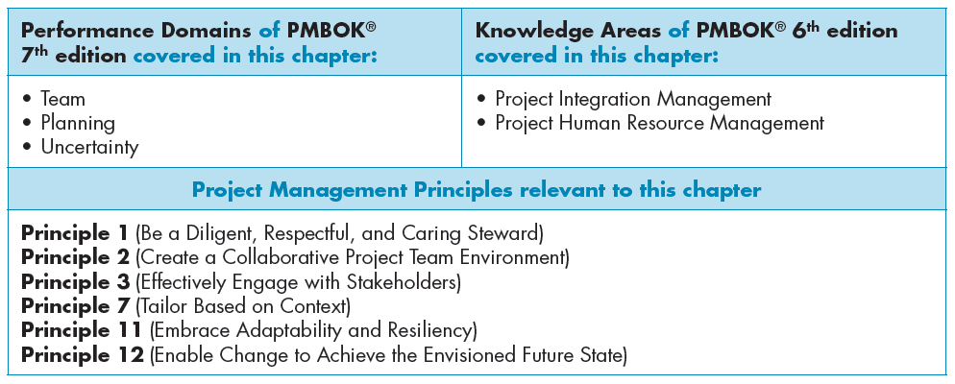

Slide 49
Functional Organisational Structure
Typically used in businesses that primarily sell and produce standard products
Work groups consist of individuals who perform the same function
Team members may be assigned to the project either full time or part time
The project manager does not have complete authority over the project team
Project manager regularly updates the other functional managers in the company on the status of the project
Notes:
Functional Organisational Structure
A functional organisational structure is typically used in businesses that primarily sell and produce standard products.
For example, a company that manufactures and sells digital recording devices
A functional organisational structure is one in which individuals are organised in groups that perform the same function or have the same expertise or skills.
Work groups consist of individuals who all perform the same function, such as engineering or manufacturing.
Each functional group concentrates on performing its own activities in support of the company’s business mission.
A company with a functional structure may periodically undertake projects, but these are typically in-house projects rather than projects for external customers.
For such projects, a multifunctional project team or task force is formed.
Team members may be assigned to the project either full time or part time.
In most cases, if an individual serves part time on a project task force, the individual continues to perform his or her regular functional job.
One of the team members is designated as the project leader or manager.
In a functional-type organisation, the project manager does not have complete authority over the project team because administratively the members still work for their respective functional managers.
The project manager needs to take the time to regularly update the other functional managers in the company on the status of the project and thank them for the support of their people assigned to the task force.

Slide 50
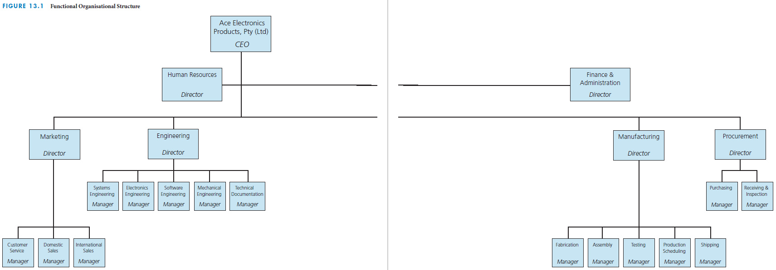
Industrial business example: functional organisational structure
Notes:
Industrial business example: Functional organisational structure
The figure on this slide depicts a functional organisational structure for an industrial business that sells standard electronics products.

Slide 51
Autonomous Project Organisational Structure
Companies with this organisation are in the projects business; they do not produce standard products
Company works on multiple projects at any given time; usually high Rand value and long term projects
As projects are completed, the company hopes to get new contracts for projects
Each project team is dedicated to only one project
Each project is operated like a mini-company
There is little opportunity for members of different project teams to share knowledge or technical expertise
Notes:
Autonomous project organisational structure
One in which each project operates as its own somewhat independent entity with dedicated resources assigned solely to each project.
Companies with an autonomous organisational structure are in the projects business; they do not produce standard products.
They typically work on multiple projects at any given time.
As projects are completed, the company continually hopes to get new contracts for projects.
Each project team is dedicated to only one project.
In the project-type organisation, each project operates like a mini-company.
All the resources needed to achieve each project are assigned full time to that project.
A full time project manager has complete project and administrative authority over the project team.
A project-type organisation can be cost-inefficient both for individual projects and for the company.
Each project must pay the salaries of its dedicated project team, even during parts of the project when they are not busy.
There is little opportunity for members of different project teams to share knowledge or technical expertise, because each project team tends to be isolated.
Project organisation structures are found primarily in companies that are involved in very large projects.
Such projects can be of high (multimillion) Rand value and long (several years) duration.
Project organisation structures are prevalent in the construction and aerospace industries.
They are also used in the non-business environment, such as for volunteer-managed projects.

Slide 52
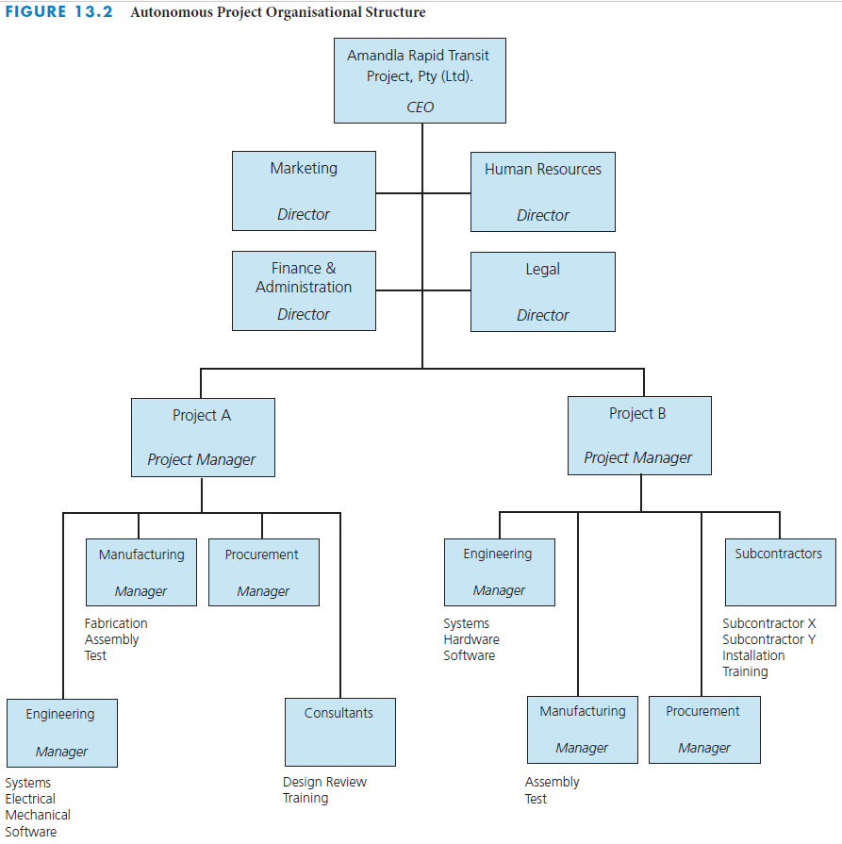
Rapid transit project business example: autonomous project organisational structure
Notes:
Rapid transit project business example: Autonomous project organisational structure
The figure on this slide depicts an autonomous project organisational structure for a business that sells rapid transit projects.

Slide 53
Matrix Organisational Structure
Multiple projects are in progress at any given time, and these projects vary in sise and complexity
Hybrid structure—a mix of both the functional and autonomous project organisational structures
Provides for effective utilisation of company resources
  Employees assigned to the project for the length of time they are needed
  Pursue career development through assignment to various types of projects
  Have a dual reporting relationship—a (temporary) project manager and a (permanent) functional manager
Project manager is the intermediary between the company and the customer
Checks-and-balances and fast response upon problem identification
Notes:
Matrix organisational structure
With the matrix organisational structure, multiple projects are being worked on at any one time and these projects can vary greatly in size and complexity.
Projects are continually begun and finished
The matrix organisation is a hybrid – a mix of both the functional and project organisation structures.
A matrix organisational structure is a hybrid of the functional and autonomous project organisational structures, in which resources from appropriate functional components are temporarily assigned to particular projects that have project managers from the project component of the organisation.
It provides the project and customer focus of the project structure, but it retains the functional expertise of the functional structure.
The project manager is responsible for the project results, while the functional managers are responsible for providing the resources needed to achieve the results.
The matrix organisation provides for effective utilisation of company resources.
Project managers come under the projects component of the organisation.
When the company receives an order for a new system, the Director of projects assigns a project manager to the project.
A small project may be assigned to a project manager who is already managing several other small projects.
A large project may be assigned a full-time project manager.
Individuals are assigned to the project for the length of time they are needed.
Some individuals may be assigned to the project full time, while others may be assigned only part time.
Some people may be assigned to a project for its entire duration; others may work on only one part of the project.
Sharing of individuals’ time across several projects results in effective utilisation of resources and minimises the overall costs for each project.
The objective is to maximise the number of functional person-hours applied to work on projects and minimise the unapplied time.
The company always needs to have new projects coming in as other projects are completed in order to maintain a high applied-time rate for the functional staff.
Individuals can pursue career development through assignment to various types of projects.
As they broaden their experience, individuals become more valuable for future assignments.
Each member of a project team has a dual reporting relationship; in a sense, each member has two managers – a (temporary) project manager and a (permanent) functional manager.
The project manager is the intermediary between the company and the customer.
She or he is responsible for leading the development of the project plan, establishing the project schedule and budget, and allocating specific work activities and budgets.
Each functional manager in a matrix organisation structure is responsible for how the assigned work activities will be achieved and who (which specific people) will do each task.
The matrix organisation provides checks and balances and a fast response upon problem identification because it has both a horizontal (project) and a vertical (functional) path for the flow of information.

Slide 54
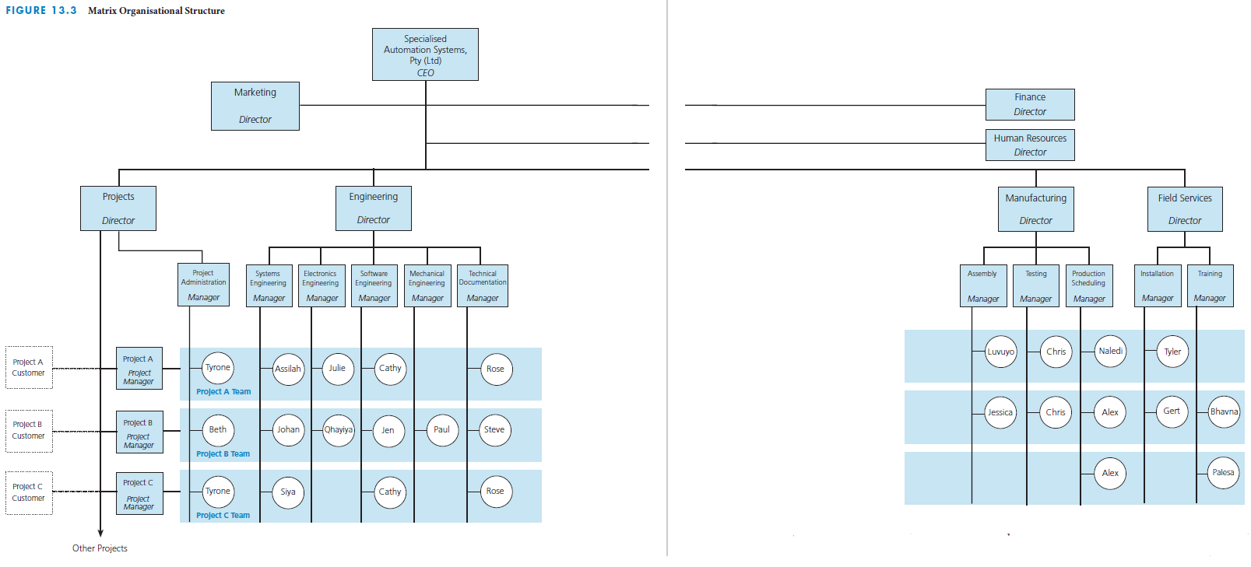
Custom computer-based automation systems example: matrix organisational structure
Notes:
Custom computer-based automation systems example: Matrix organisational structure
The figure on this slide depicts a matrix organisational structure for a business that sells custom computer-based automation systems.

Slide 55
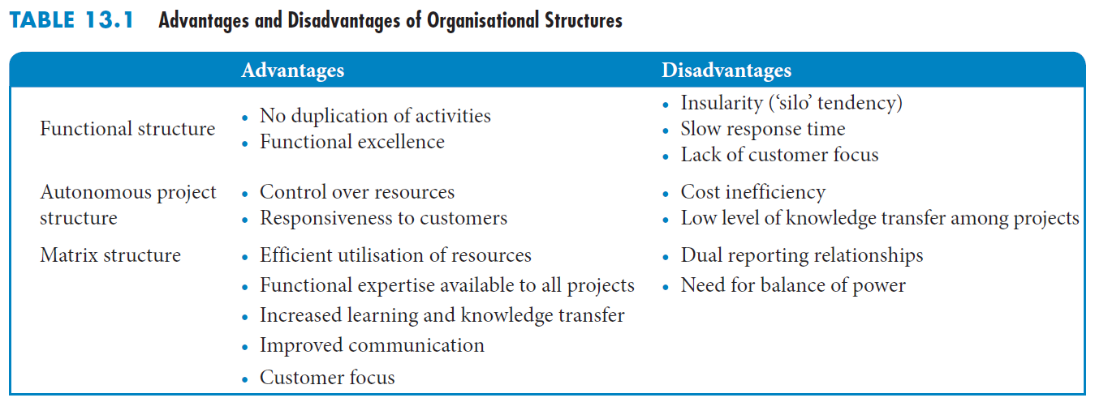
Advantages and Disadvantages of Organisational Structures
Notes:
Advantages and disadvantages of organisational structures
Here you see a table that depicts the advantages and disadvantages of the different types of organisational structures.
Functional organisational structure:
Advantages:
A functional-type organisation removes potential for duplication and overlap of activities.
It provides the benefits associated with specialisation and functional excellence.
Disadvantages:
Functional-type organisations can be insular, with each component only concerned about its own performance.
Team work is not emphasised; there is little cross-fertilisation of ideas.
Decisions may be parochial rather than in the best interests of the overall project.
The hierarchical structure causes communication and problem resolution problems, and decision making can be slow.
There is a lack of customer focus.
There is a stronger allegiance to the function than to the project or the customer.
Autonomous project organisational structure
Advantages:
The project team has full control over the resources, including authority over how the work gets completed and by whom.
The project organisation is highly responsive to the customer.
Disadvantages:
This structure can be cost-inefficient because of under-utilisation of resources. When things are slow, individuals have a tendency to stretch out their work to fill up the time available or if they do not have any tasks to do for temporary periods, they still must be paid by the company.
There is a potential for duplication of activities on several concurrent projects.
There is a low level of knowledge transfer between projects.
Individuals are dedicated to working on one project.
At the end of a project, people may be made redundant if there is no new project to which they can be assigned, leading to team members to experience high anxiety about reassignment.
Matrix organisational structure
Advantages:
It allows efficient utilisation of resources by assigning individuals from various functions to work on specific projects.
Because they have a functional home, individuals can be moved between projects.
It provides a core of functional expertise that is available to all projects.
Knowledge stays with the company, ready to be used on future projects.
People experience greater learning and growth, and their knowledge and skills are transferred from project to project.
The matrix structure also facilitates information flow.
Project team members can inform the project manager and the functional manager.
The matrix organisation is customer focused.
Disadvantages:
Members of a project team in a matrix organisation structure have a dual reporting relationship, which can cause anxiety and conflict over work priorities.
A company that uses a matrix organisation structure must establish operating guidelines to assure a proper balance of power between project managers and functional managers.
Conflicts are likely to arise between project managers and functional managers regarding priorities.

